Slide 2
What if We Stopped Driving and Saved the Trees? An App for Reducing Your Carbon Commute
Isaac Allan, Caleb Hazelton
COMP730, Fall 2025

Slide 3
One of the most prominent sustainability issues?

Slide 4
Carbon Emissions

Slide 5
Narrative: What we aim to build?
We aim to create a simple application to help users:
Visualize their Transportation carbon footprint.
Reduce their Transportation carbon footprint.
The main features for this application include:
Allows users to add and manage their vehicles.
Allows users to create trips with a chosen vehicle.
Display the total carbon emissions for a created trip.
Save trips.
Summarize carbon footprint by week, month, and year.
Save & Load session data.

Slide 6
External Services: Google Compute Routes Matrix
Creator: Google
Description: Publicly available API providing distance, time, and route information in JSON format
Release Date: May 2023 (builds upon Distance Matrix API from 2005)
Input Requirements: origin, destination, travelMode, and field mask
Request Method: POST HTTP request
Usage Limits: 10,000 free calls per project
URL: Google Routes API Documentation

Slide 7
External Services: Vehicle Fuel Economy Dataset
Creator: United States Department of Energy
Data Source: Environmental Protection Agency's National Vehicle and Fuel Emissions Laboratory in Ann Arbor, Michigan
Publication Schedule:
  Annual guide for each year's vehicles
  Monthly updates to running list of current year data
  Master list containing all years' data (updated monthly)
Latest Update: October 6th, 2025
Content: Comprehensive vehicle data including cylinder count, passenger capacity, and fuel efficiency metrics
URL: www.fueleconomy.gov/feg/download.shtml

Slide 8
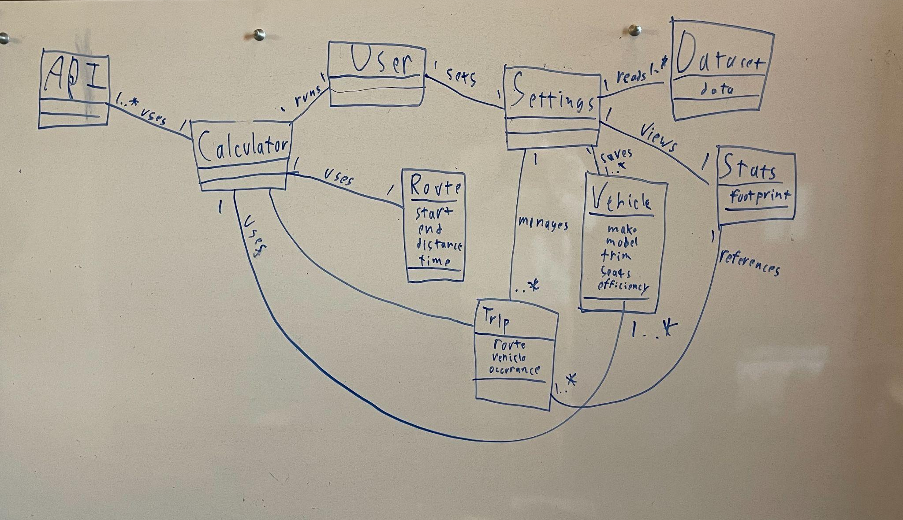
Whiteboard Session: Domain Model

Slide 9
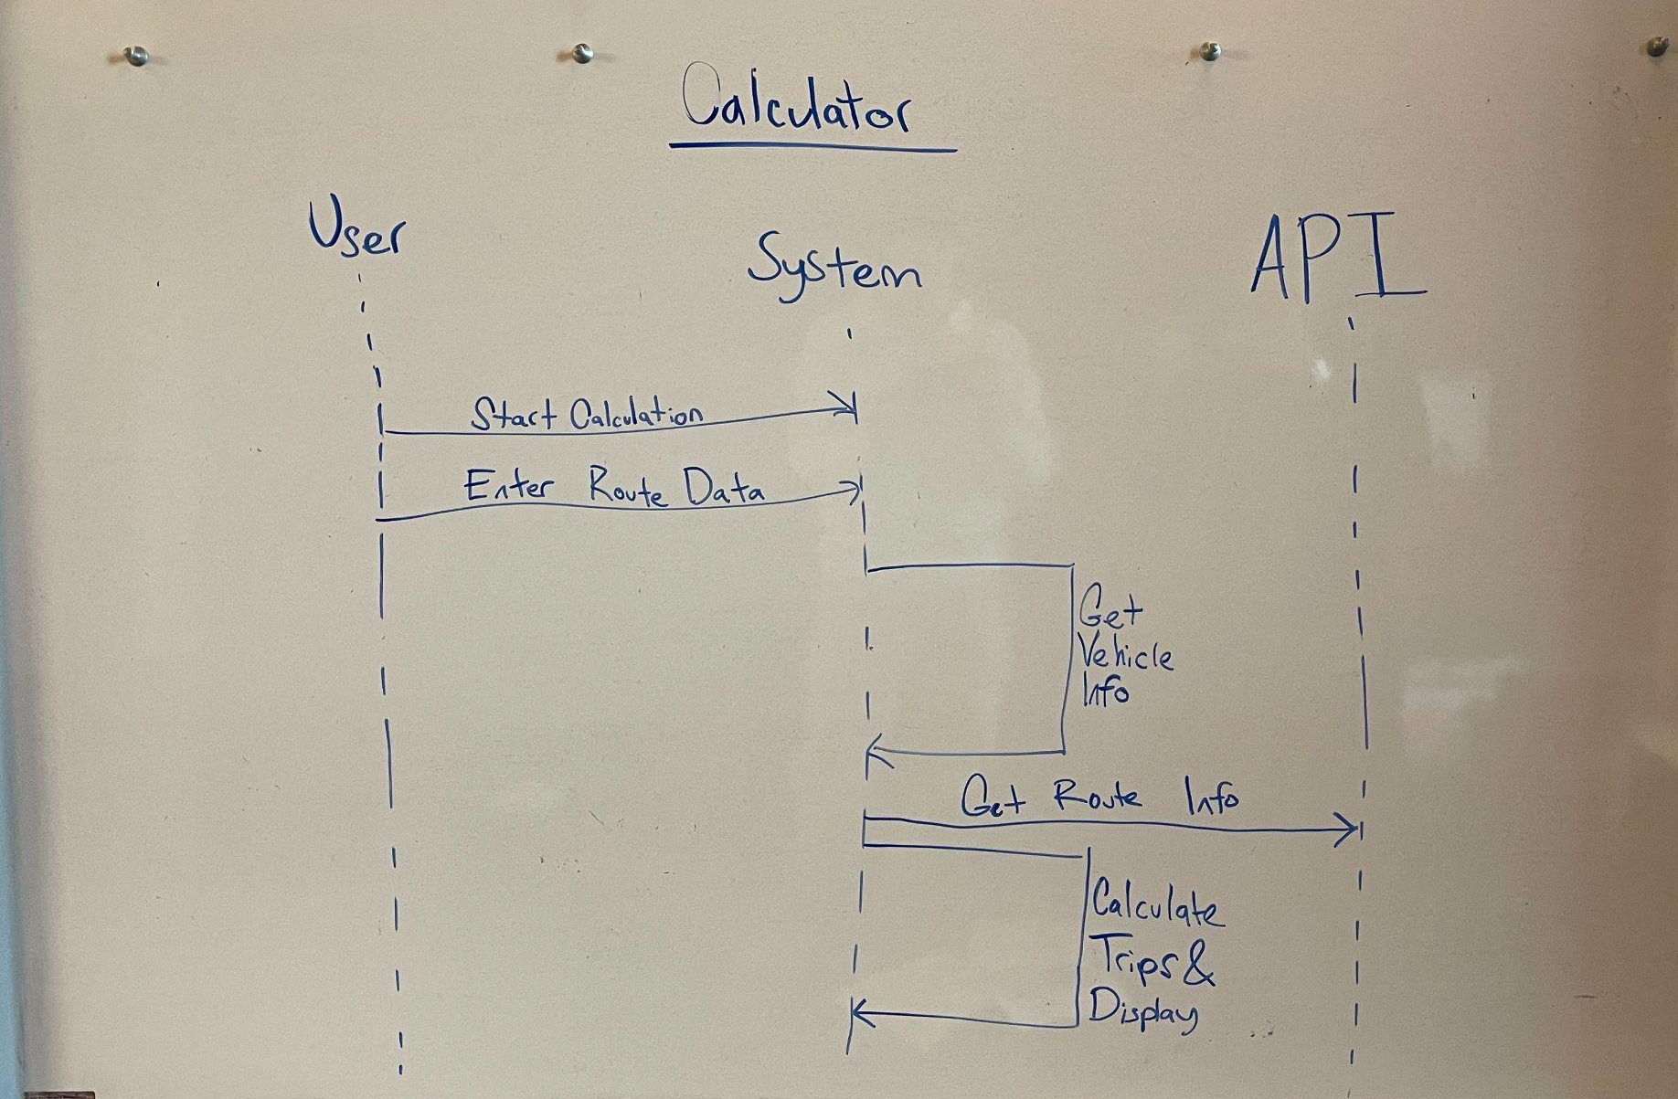
Whiteboard Session: Calculator System Sequence Diagram

Slide 10
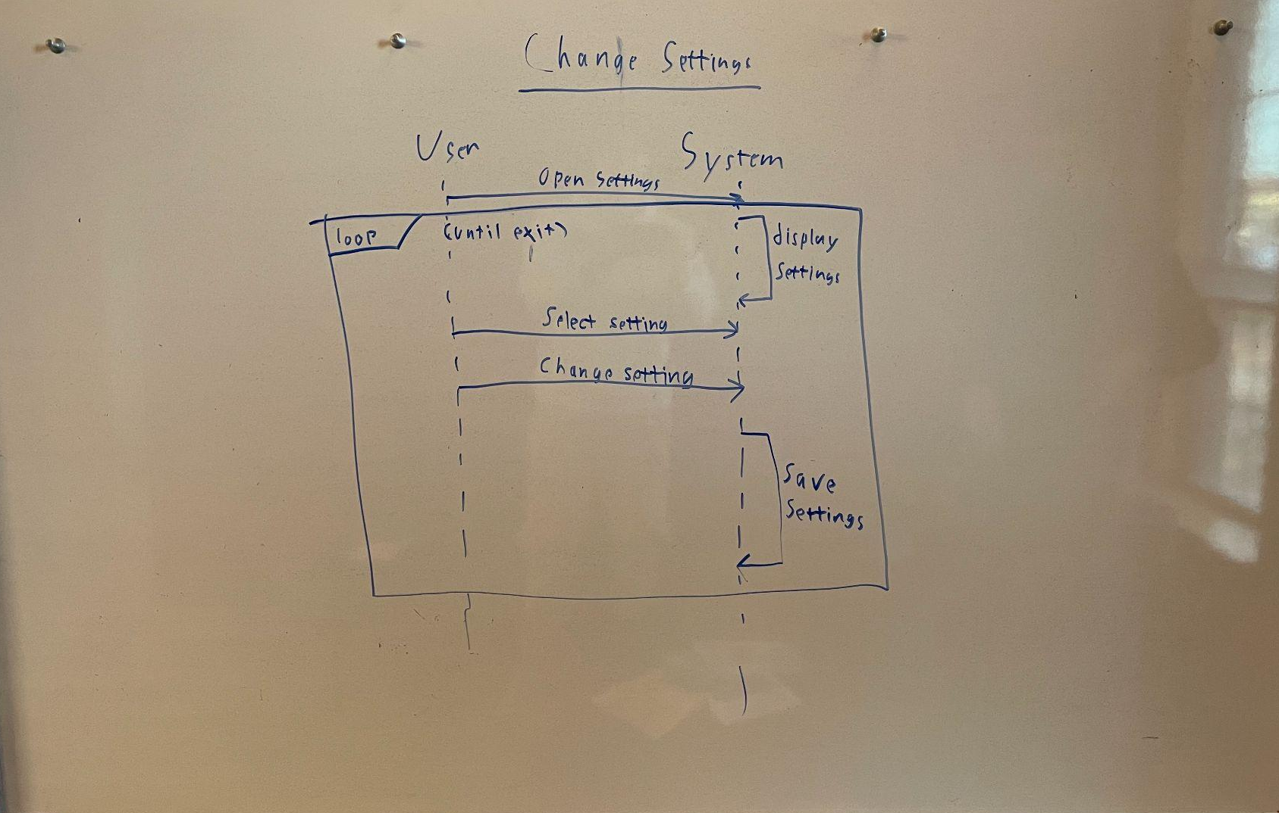
Whiteboard Session: Settings System Sequence Diagram

Slide 11
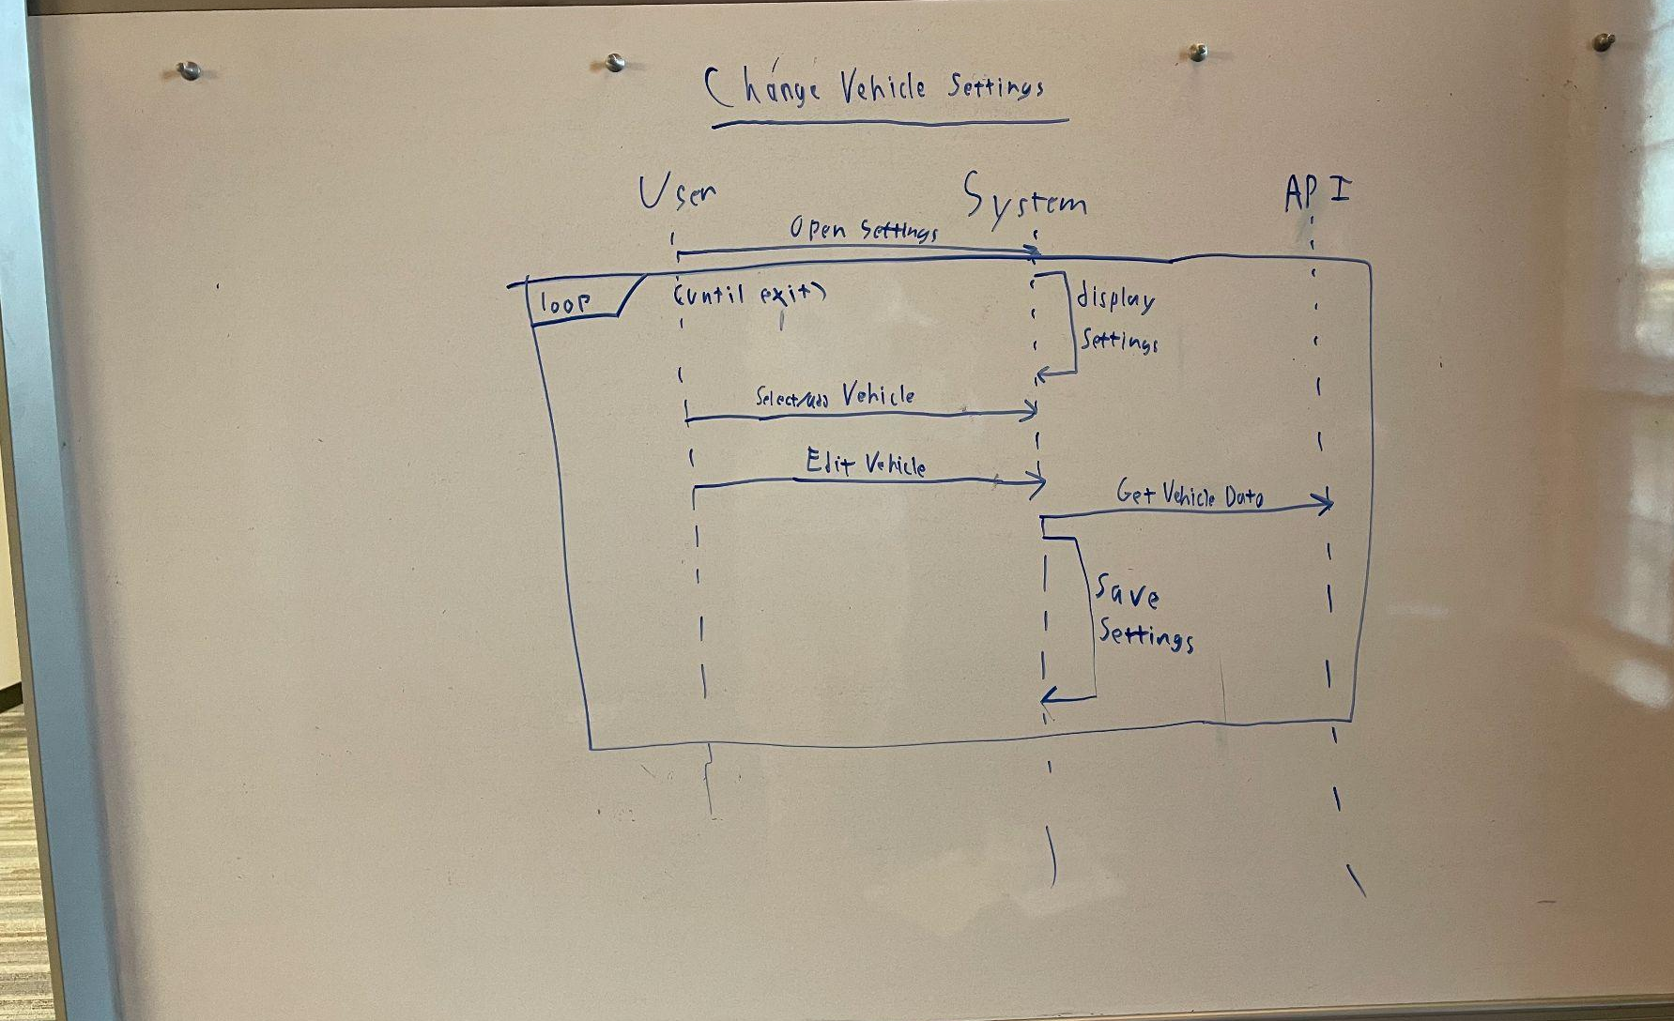
Whiteboard Session: Vehicle Settings System Sequence Diagram

Slide 12
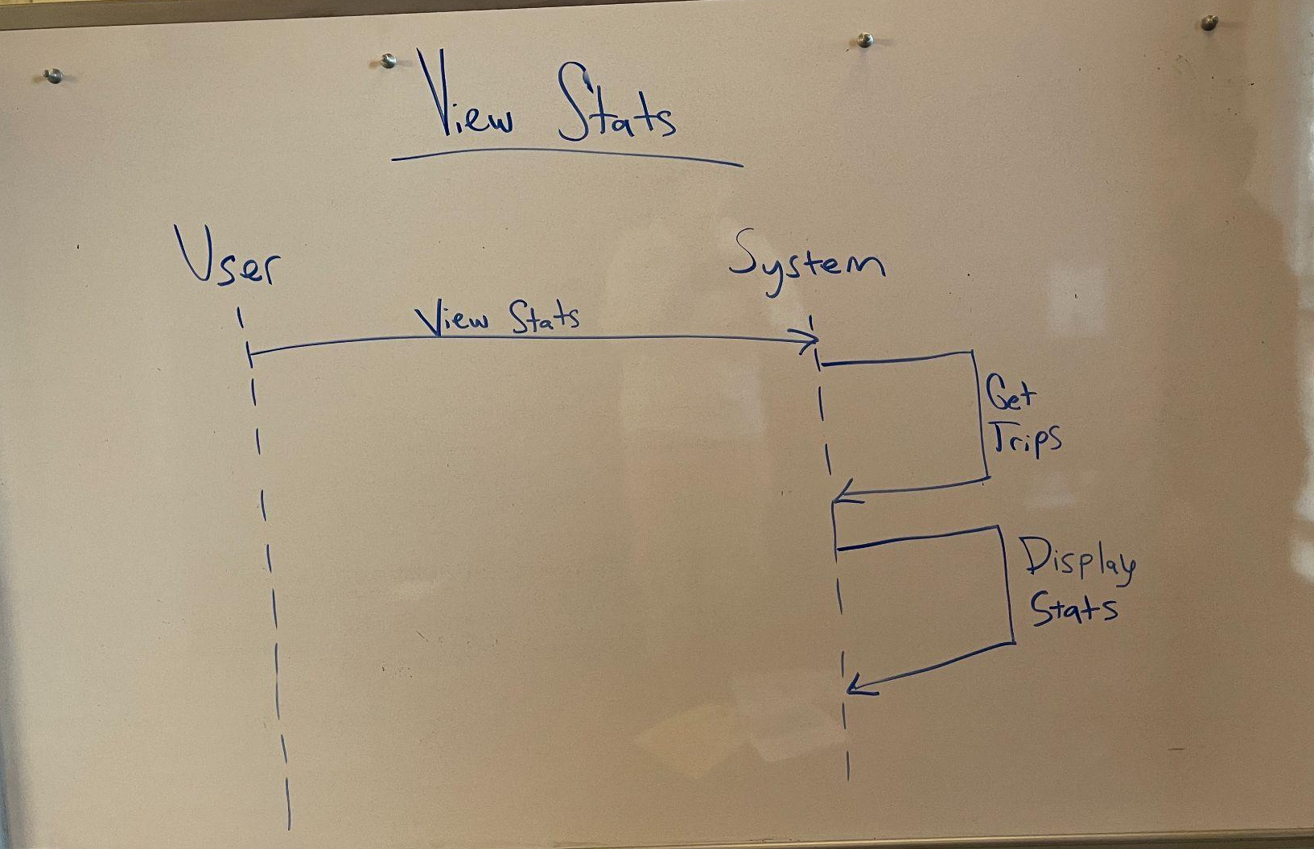
Whiteboard Session: Statistics System Sequence Diagram

Slide 13
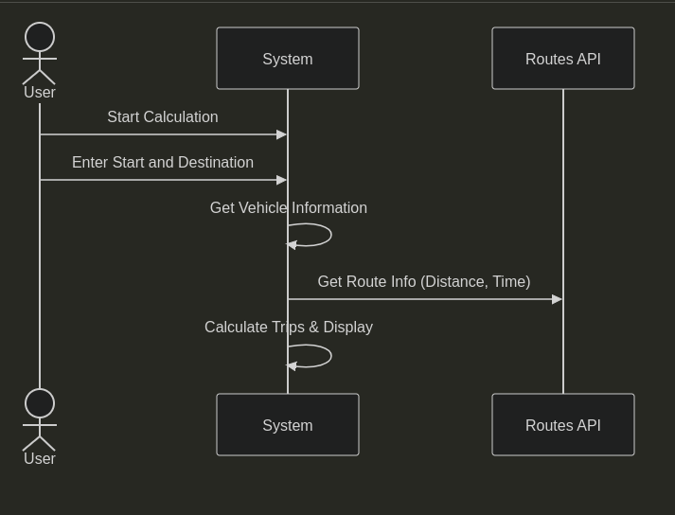
Mermaid: Calculator System Sequence Diagram

Slide 14
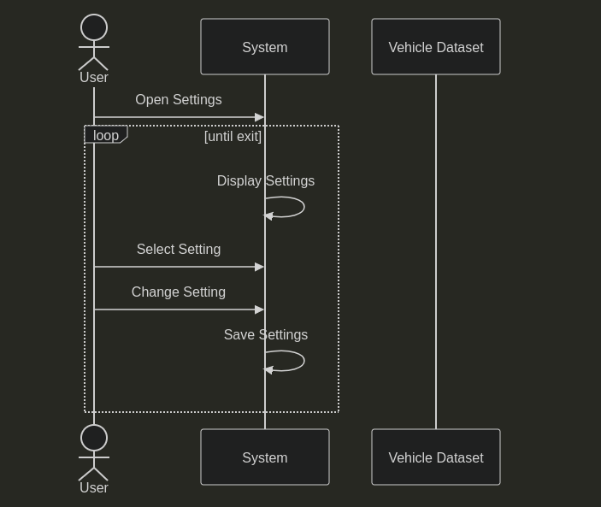
Mermaid: Settings System Sequence Diagram

Slide 15
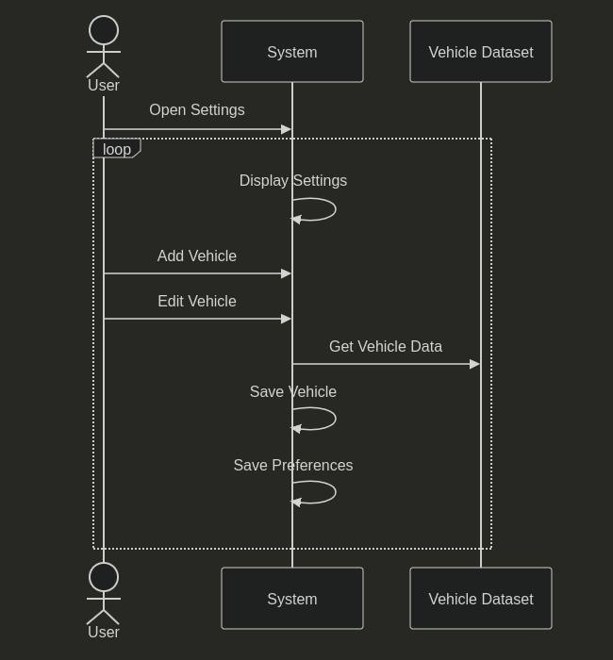
Mermaid: Vehicle Settings System Sequence Diagram

Slide 16
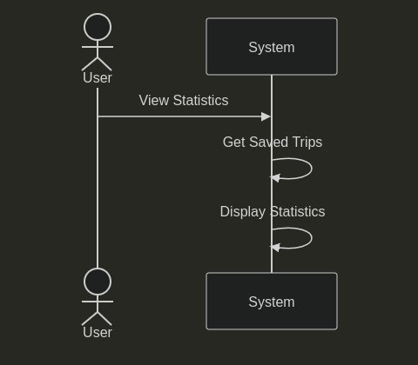
Mermaid: Stats System Sequence Diagram

Slide 17
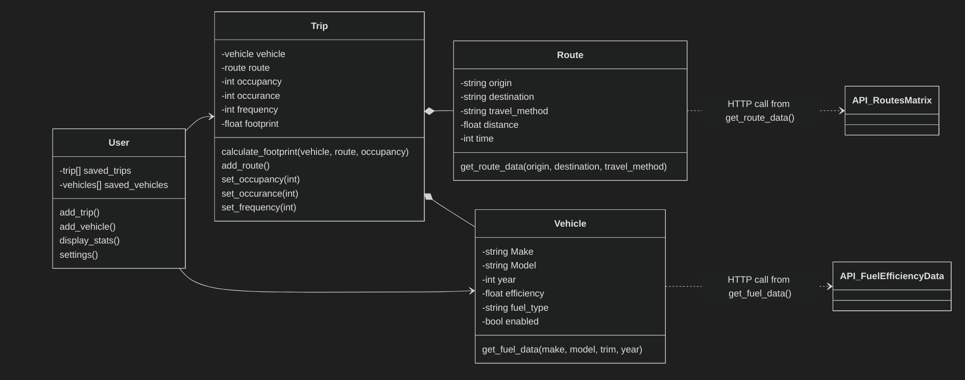
Class Diagram:

Slide 18
Environment
[project]
name = "carbon-commute"
version = "0.1.0"
description = "What if we stopped driving and saved the trees? An application to calculate and manage your carbon footprint based of off your commuting methods."
authors = [
{name = "Caleb Hazelton",email = "caleb.hazelton@gmail.com"}
]
readme = "README.md"
requires-python = ">=3.13,<4"
dependencies = [
"pdoc (>=16.0.0,<17.0.0)",
"requests (>=2.32.5,<3.0.0)",
"python-dotenv (>=1.2.1,<2.0.0)",
]
[build-system]
requires = ["poetry-core>=2.0.0,<3.0.0"]
build-backend = "poetry.core.masonry.api"
Poetry
pdoc
Google Routes API
Fuel Economy Data

Slide 19
Codespace Walkthrough
&
Demo

Slide 20
Contributions
Caleb
Whiteboard sessions
Poetry setup
Routes API
Stats calculation
Main implementation
Isaac
Whiteboard sessions
pdoc integration
Vehicle dataset integration
File I/O
Testing

